Slide 1
Online Salon Service Application
Using Spring Boot
Batch-8-J2EE
Name : Shanigarapu Yugender
E-Mail : bunnyyugender@gmail.com
Date : Sep-01-2024
Trainer: Ramakrishna (RK)

Slide 2
Content
Introduction
Problem Statement
Technologies Used
Microservices Architecture
Admin and User Modules
Testing and Refinement
Conclusion

Slide 3

Project Flow
API Gateway
1
2
3
4
5
Server Registry &
Discovery
Microservices Management
Admin Module
And
User Module
Junit
And
Ui/Ux
Authentication Service

Slide 4
INTRODUCTION
The "Online Salon Service Application" is a distributed system developed using Spring Microservices, designed to streamline salon management and service booking.
The application allows salon admins to manage services, staff, and bookings efficiently, while providing users with an easy-to-use platform to browse services, book appointments, and manage their bookings.
By leveraging microservices architecture, the application ensures scalability, flexibility, and robust performance, catering to both admin and user needs with secure authentication and smooth interaction between various services.
The project aims to enhance the overall customer experience in the salon industry through modern, efficient technology

Slide 5
Problem Statement
Problem Statement
The salon industry often faces challenges in managing appointments, services, and staff efficiently, leading to customer dissatisfaction due to scheduling conflicts, poor service management, and lack of transparency. Traditional booking methods can be time-consuming and error-prone, making it difficult for salons to maintain an organized and customer-friendly operation. Additionally, customers often struggle to find and book services conveniently, leading to frustration and missed business opportunities

Slide 6
Technologies Used
Java: The core programming language used for developing the entire application, providing a robust and scalable environment for building enterprise-level applications.
Spring Boot: A framework that simplifies the development of production-ready applications with minimal configuration, enabling rapid development and deployment of the microservices.
Spring Cloud: A suite of tools for building and managing distributed systems, offering features like service discovery, API gateway management, and configuration management, essential for microservices architecture.
Spring Data JPA: A module that provides a simplified and consistent way to interact with the database using Java Persistence API (JPA), enabling efficient data access and management in the microservices.
MySQL/MariaDB: The relational database management systems used for storing and managing the application's data. They offer reliability, high performance, and ease of use, making them suitable for handling the database needs of the application.
RESTful APIs: The communication mechanism between the microservices, allowing them to interact with each other and with the client applications. RESTful APIs provide a standardized way to access and manipulate resources, ensuring seamless integration and operation of the distributed system

Slide 7
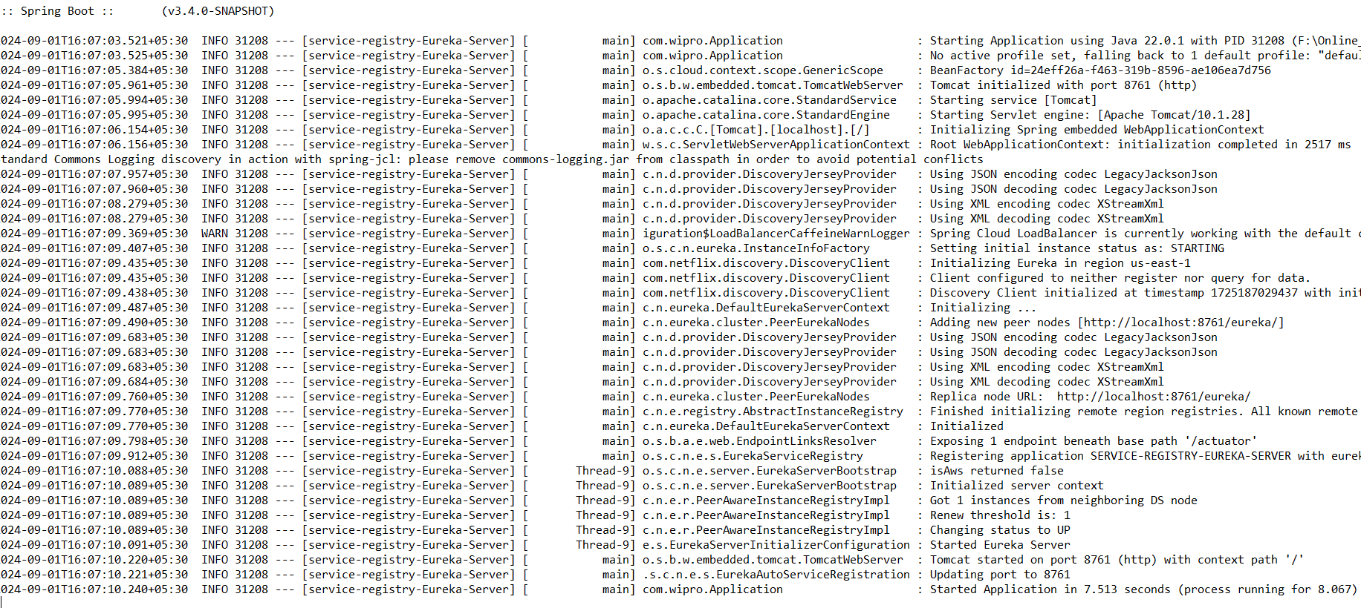
Microservices Architecture
Service Registry & Discovery
Eureka Server:
Acts as a centralized service registry where all microservices register themselves upon startup.
Enables dynamic discovery of services, allowing microservices to find each other without hardcoding their locations.

Slide 8
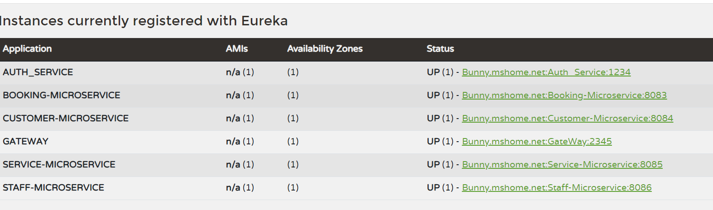
Eureka dashboard

Slide 9
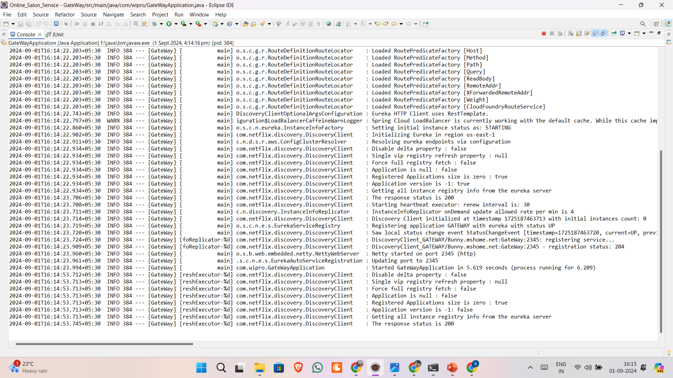
API Gateway
Spring Cloud Gateway:
Serves as the entry point for all client requests.
Routes incoming requests to the appropriate microservice based on predefined rules.
Provides cross-cutting concerns like security, rate limiting, and logging, which are applied uniformly across all services.

Slide 10
Authentication Service
JWT-Based Authentication:
Manages user authentication and authorization.
Handles user registration, login, and generates JSON Web Tokens (JWT) for secure API access.
Differentiates between roles (Admin and User), controlling access to various parts of the application.

Slide 11
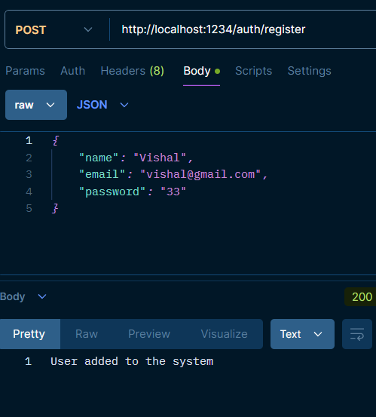
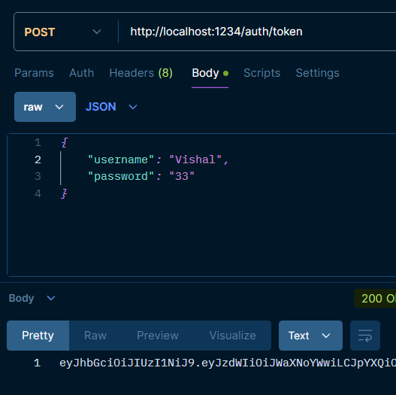
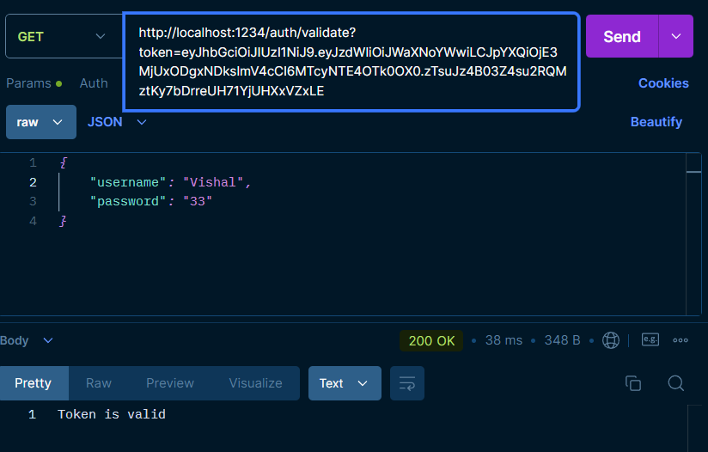
Authentication Service OutPut’s
For Register
For Token generation
For Token validation

Slide 12
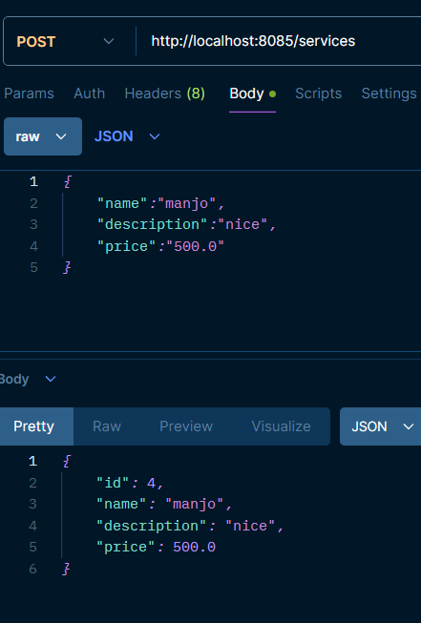
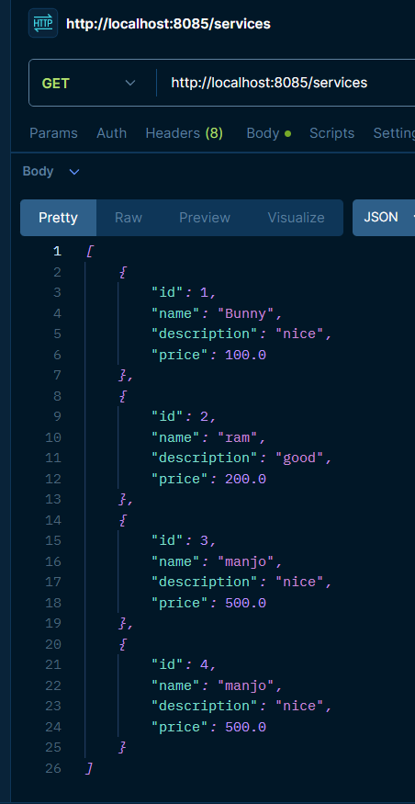
Service Management Microservice
Managing Salon Services :
Handles all CRUD (Create, Read, Update, Delete) operations related to salon services.
Provides APIs to add, edit, delete, and fetch service details.
Utilizes Spring Data JPA to interact with the database, ensuring efficient and reliable data management.
Output’s

Slide 13
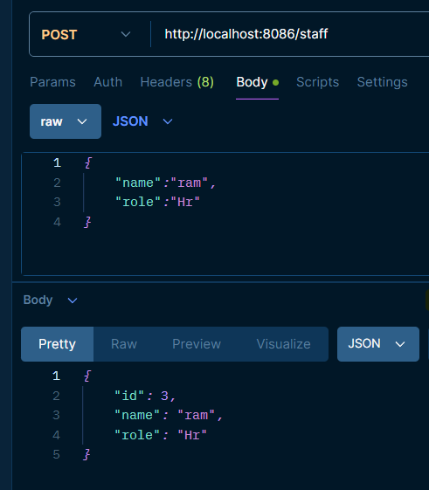
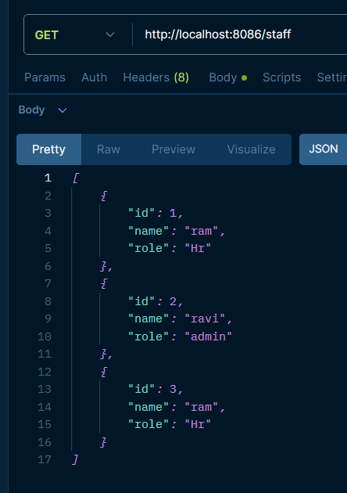
Staff Management Microservice
Managing Staff Assignments and Details:
Manages information related to salon staff, including their assignments to specific services.
Offers APIs to add, edit, delete, and view staff details.
Ensures staff availability and assignment are maintained to avoid conflicts.
Output’s

Slide 14
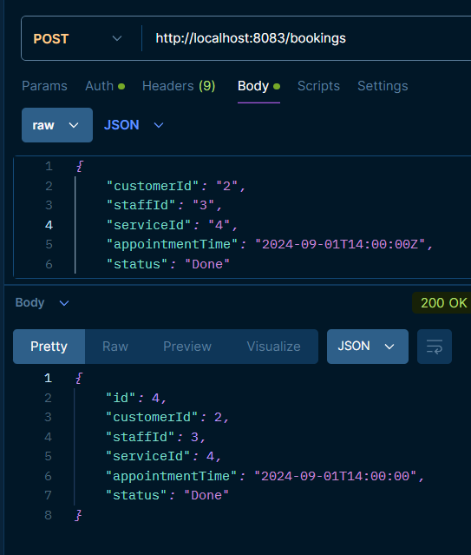
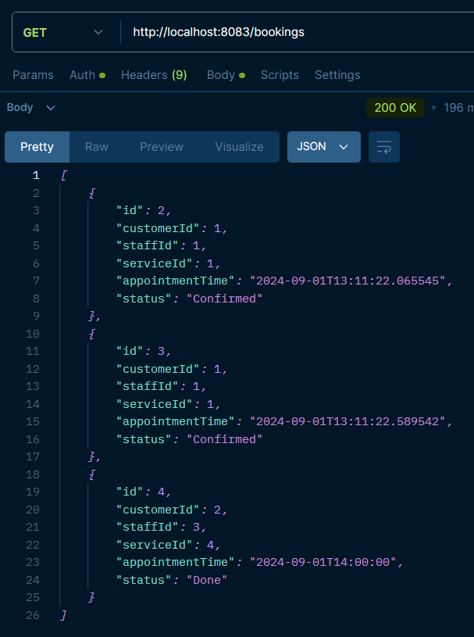
Booking Management Microservice
Handling Appointment Bookings and Validations:
Manages the entire booking lifecycle, from creation to modification and cancellation.
Validates bookings to prevent double-booking of staff members.
Manages booking statuses such as pending, confirmed, completed, and canceled.
OutPut’s

Slide 15
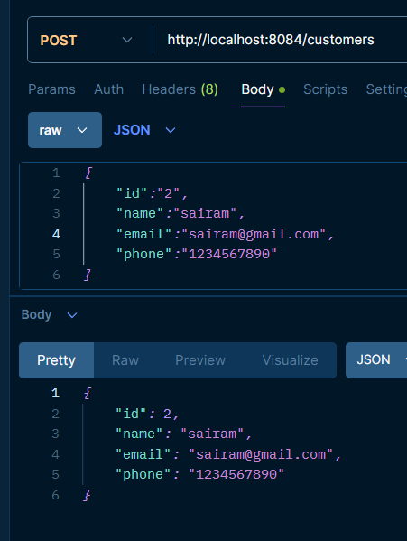
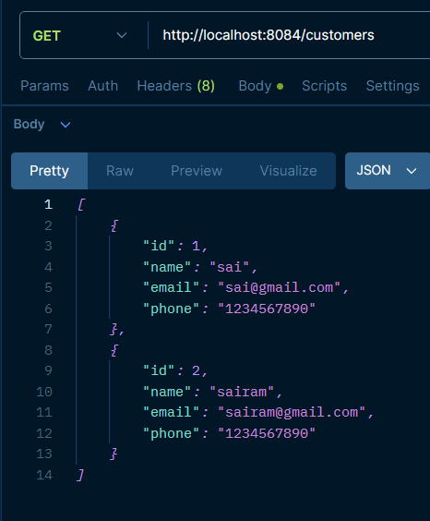
Customer Management Microservice
OutPut’s
Managing Customer Profiles and Booking History:
Handles customer data, including profiles and booking history.
Provides APIs for customers to manage their profiles and view past appointments.
Ensures secure access and management of customer information.

Slide 16
Admin Module
Admin Dashboard Overview
The Admin Dashboard is the central hub where the admin can monitor and manage all aspects of the salon's operations. It provides a consolidated view of key metrics, ongoing appointments, and staff availability, enabling the admin to make informed decisions and oversee the entire application effortlessly.
Managing Services
Through the Admin Dashboard, the admin can perform CRUD (Create, Read, Update, Delete) operations on salon services. This includes adding new services, updating details like pricing or duration, deleting outdated services, and viewing a comprehensive list of all available services.
Managing Staff
The admin has full control over the staff directory, including the ability to add, edit, or remove staff members. The Admin Dashboard allows for assigning staff to specific services, managing their schedules, and ensuring that staff availability aligns with customer bookings.
Managing Bookings
The admin can oversee all bookings made by customers, with the ability to modify booking details, reassign staff, or update the booking status (e.g., pending, confirmed, completed, canceled). The dashboard provides real-time information on all upcoming appointments and helps prevent scheduling conflicts.
Managing Customers
The admin can access and manage customer profiles, including viewing their booking history and personal details. The Admin Dashboard allows the admin to update customer information, address any issues related to bookings, and maintain a comprehensive customer database.

Slide 17
User Module
1. User Registration and Authentication
New users can sign up, and existing users can log in securely.
The system uses JWT (JSON Web Tokens) to ensure that only logged-in users can access the application.
Handles role-based access, allowing different permissions for regular users and admins.
2. Browsing and Booking Salon Services
Users can browse a list of salon services, view details, and check availability.
They can book appointments by choosing a service, date, time, and preferred staff member.
3. Managing User Appointments
Users can view their upcoming and past appointments.
They can modify or cancel bookings if needed.
Automated notifications keep users informed about their appointments.

Slide 18
Testing and Refinement
Unit Testing with JUnit and Mockito
All my Junit test’s is passed

Slide 19
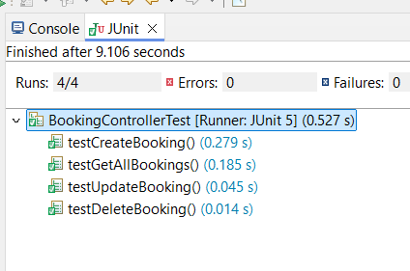
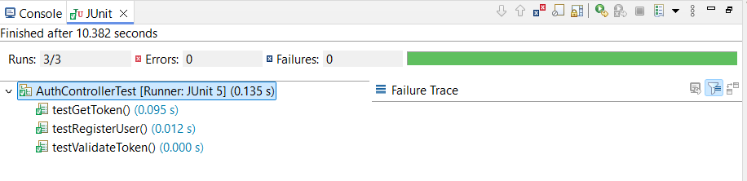
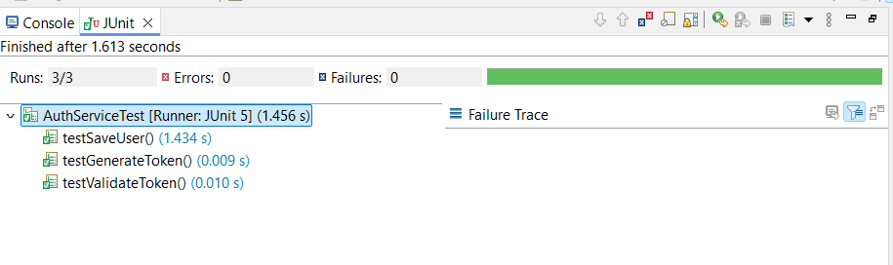
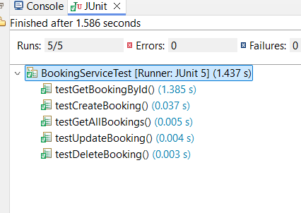
Junit test for Auth_service
Junit test for Booking_service

Slide 20
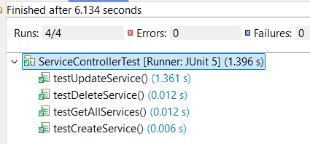
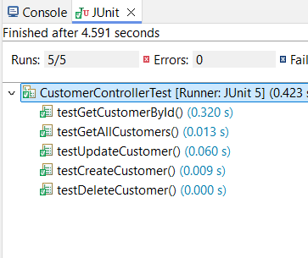
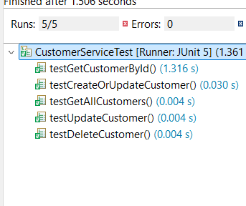
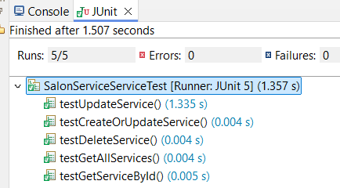
Junit test for Customer-service
Junit test for Service-service

Slide 21
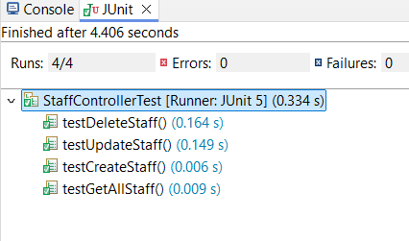
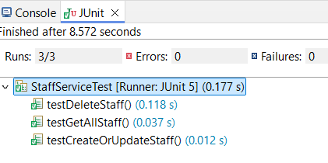
Junit test for Staff-Service

Slide 22
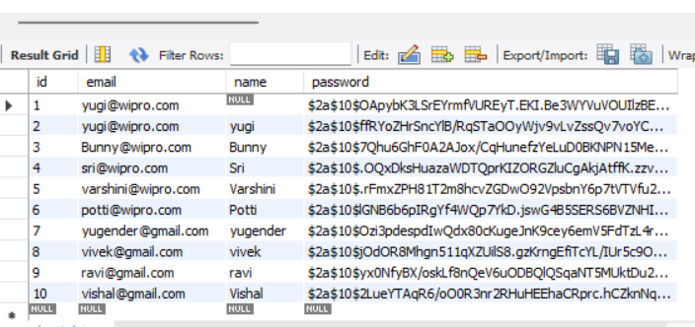
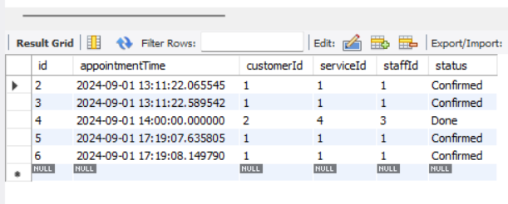
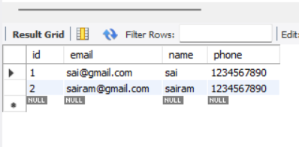
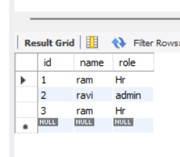
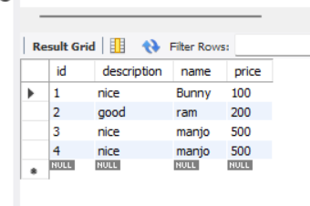
All My Data Bases

Slide 23
Conclusion
Developed a distributed Online Salon Service application using Spring Microservices.
Created a robust admin module for managing services, staff, bookings, and customers.
Provided a user-friendly interface for customers to browse and book services.
Achieved seamless integration and communication between microservices.
Implemented secure JWT-based authentication for admins and users.
Built a scalable architecture for easy addition of new features.
Conducted thorough unit and integration testing to ensure reliability.
Project Outcomes

Slide 24
THANK YOU
Shanigarapu Yugender
bunnyyugender@gmail.com

